Slide 1
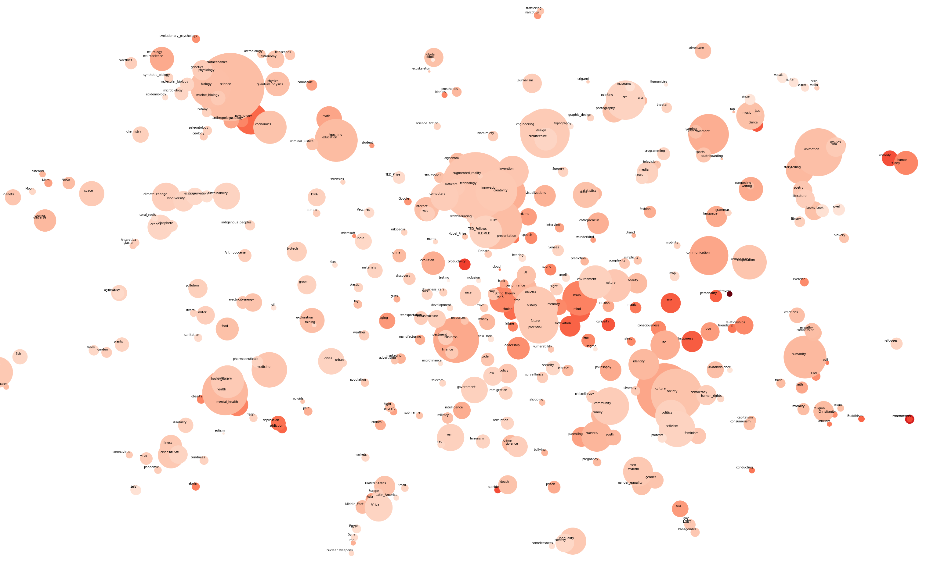
Similarity of topics key words

Slide 2
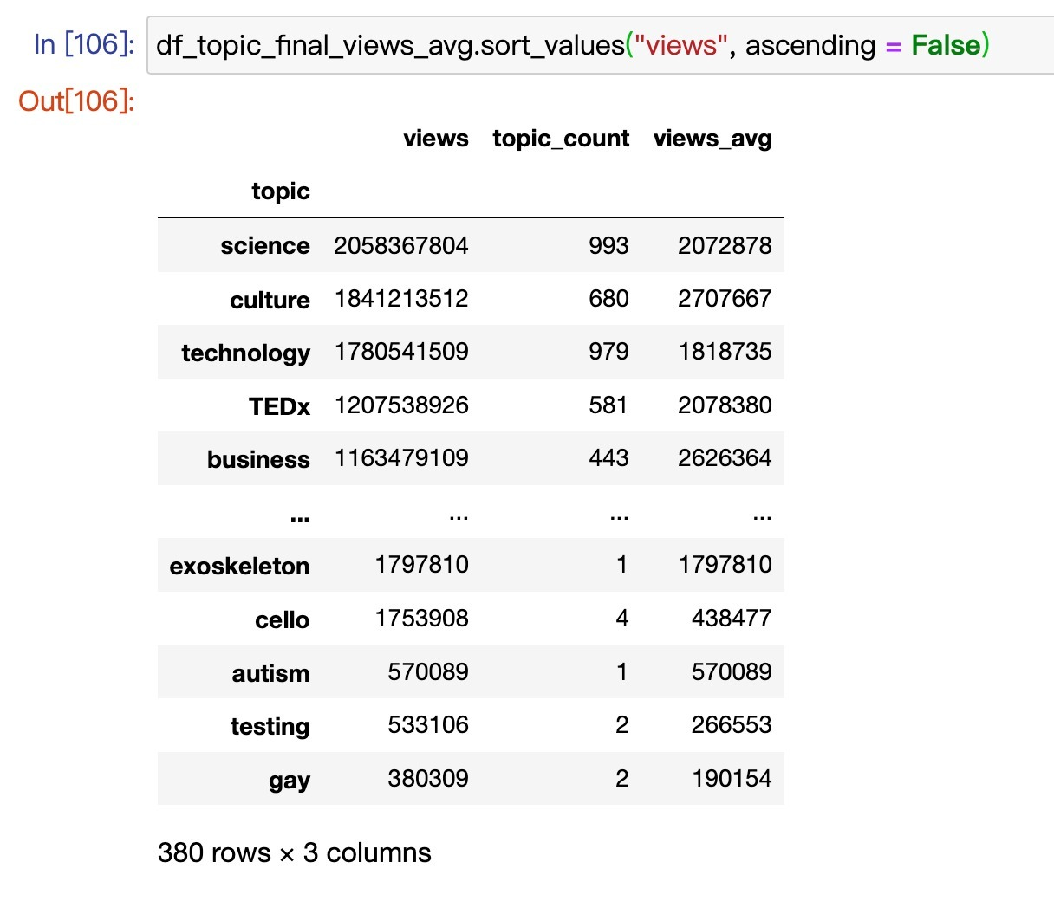
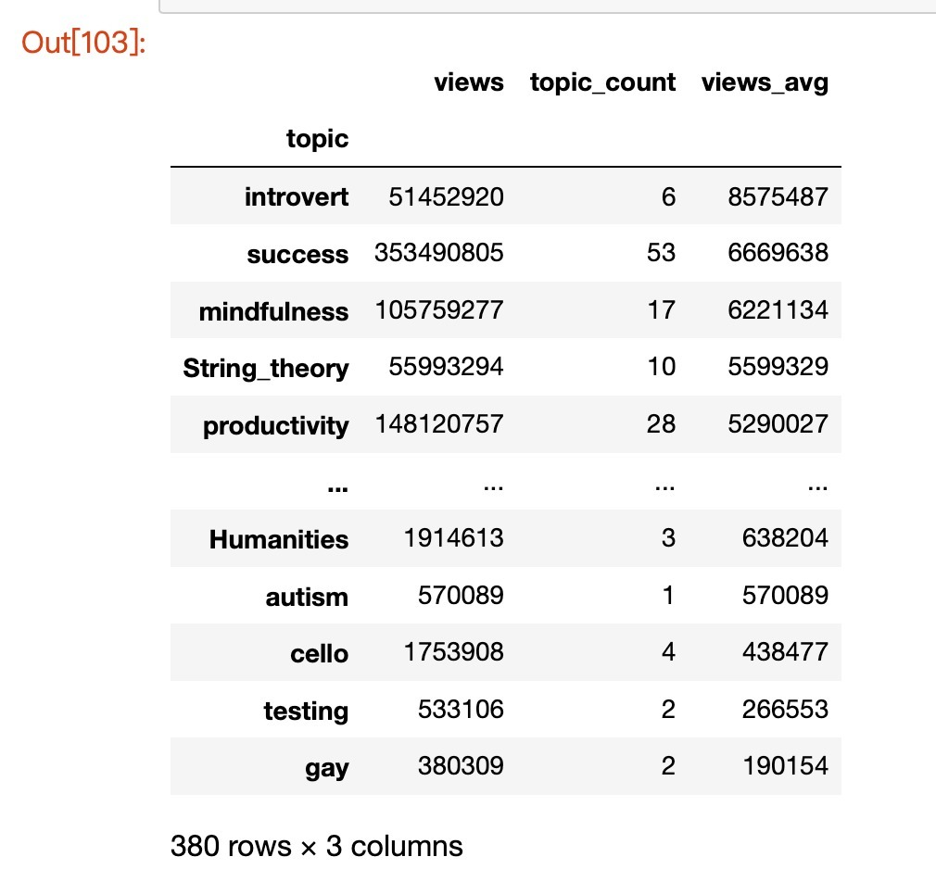
Similarity of topics key words
Among the 4005 talks with unique topics, some of the keys words appears very frequently while some don’t
A brief look into the topics by its key words, 458 distinct key words are found. Output shows the key words ranked by “views” and “views_avg”
views: total views of the talks with the key word
"topic_count“: count of key word appears in 4005 talks
views_avg: “Views” divided by "topic_count"
Word2vec analysis: a natural language processing using a neural network model to learn word associations from a large corpus of text. With the limited resource and time, an open-source training dataset "word2vec-google-news-300“ is used for the word embedding and its similarity. Among the 4005 talks topics and 458 distinct keywords, 380 out of 458 words appeared in the google training dataset, which is justify for our project scope.
due to the use of large size gensim word2vec api, colab is used during data processing and plot graph

Slide 3
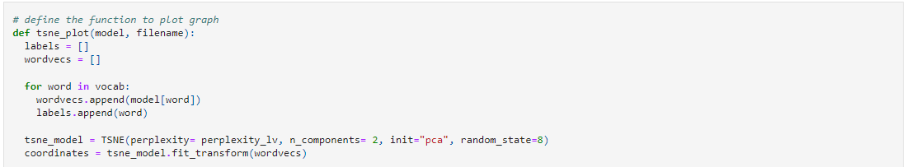
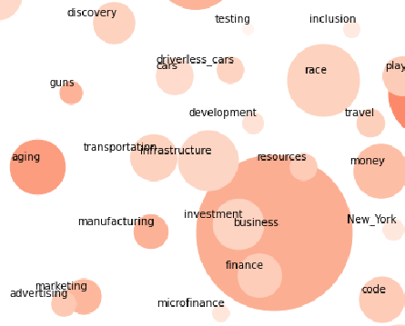
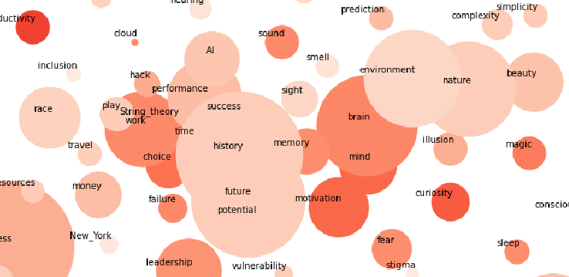
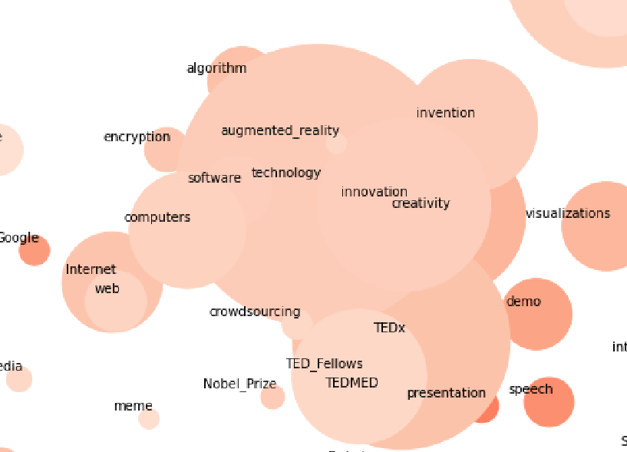
Word2vec analysis
With using “tsne.plot” and principal components analysis to plot the trained word2vec models result of the 380 key words, we can understand the clustering of the key words according to their similarity.
The size of the nodes refers to the number of topics having the key words, and the color refers to the “views”
Other than focusing on big dark nodes (existing_hot_topics), small dark nodes (upcoming_topics) should also be focused.
Business related
Future and Self-growing related
technology related

Slide 4

By views
science and education
Entertainment
and
happiness
technology
business
Future and self development
Human
and
religion
Health and disease

Slide 5
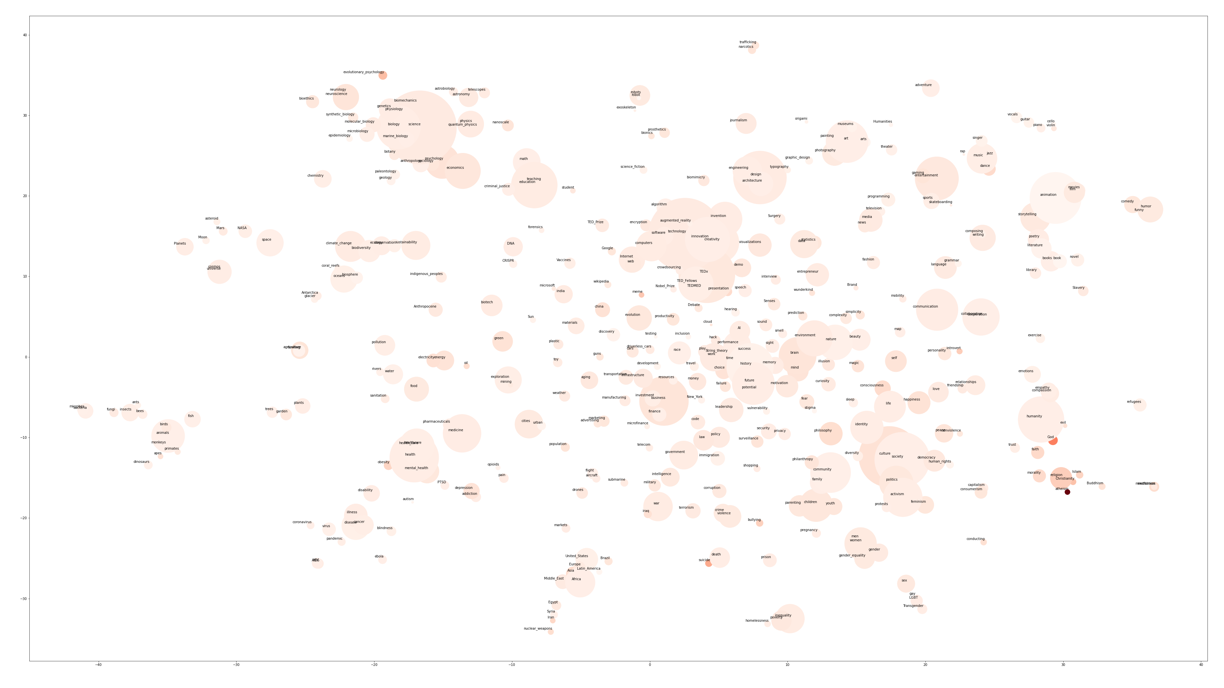
By comments

